Slide 1
Senior Analyst Take Home Test
Sagar Doshi

Slide 2
Question 1

Slide 3
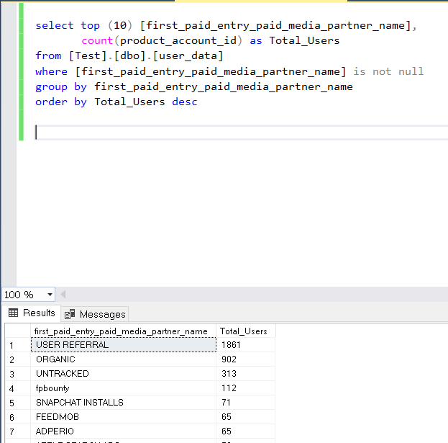
Output

Slide 4
Question 2

Slide 5
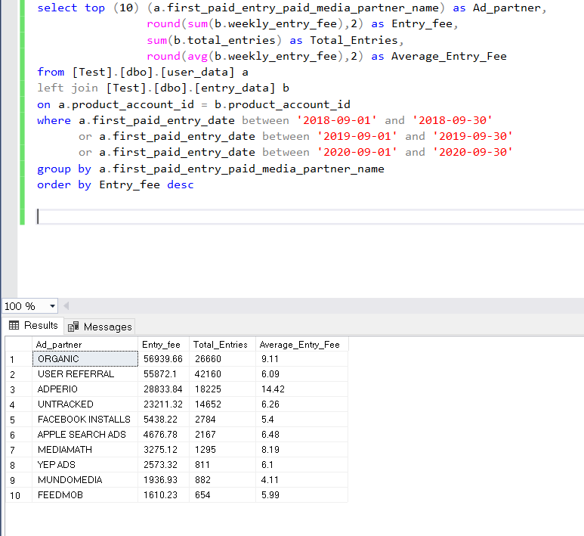
Output

Slide 6
Question 3

Slide 7
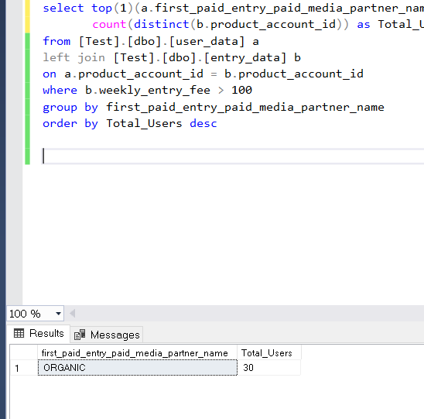
Output

Slide 8
Question 4

Slide 9
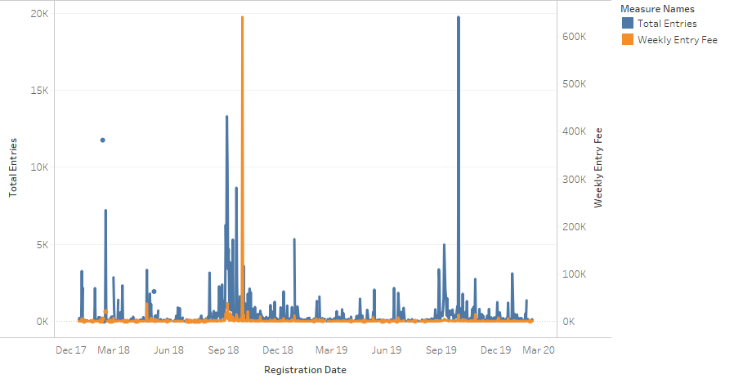
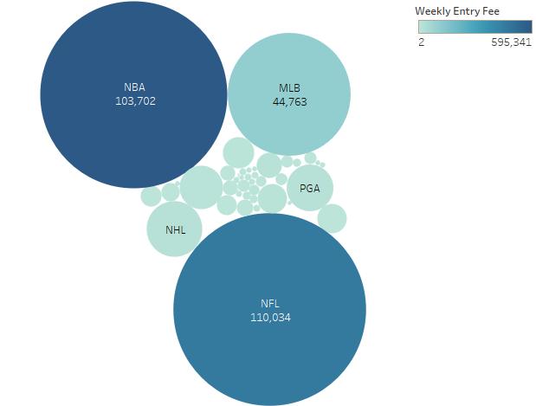
Seasonal Trends
The time series chart shows total entries and entry fee by registration date
The bubble chart shows total entries and entry fee by entry sport where shade represents the entry fee generated and size represents the total entries by sport.
The time frame for these charts are 1/1/18-12/31/19
We see from the time series chart that the peak periods are Aug-Dec which is understandable as our main entry driving sports like NFL,NBA,MLB etc occur during that time.
We can heavy up on our marketing in two phases. Phase one (Jan-July) were we can focus on increasing our brand awareness and engaging registrations while in Phase two (Aug –Dec) we can focus on getting more Conversions and entries.

Slide 10
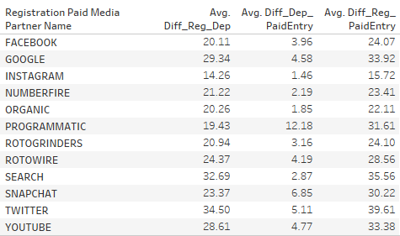
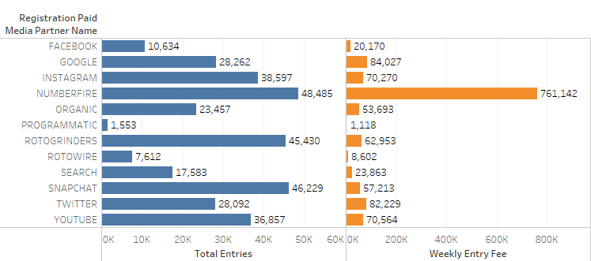
Time to Conversion by Partner
The table on the right represents the average time it took by partner from Registration to Deposit (Diff_Reg_Dep), Deposit to Paid Entry (Diff_Dep_PaidEntry) and from Registration to Paid Entry (Diff_Reg_PaidEntry) in days.
The table on the bottom shows the Total Entries and Weekly Entry fee generated by Registration Partner over time.
Using these observations, we can assume that for immediate conversions, we can rely on partners like Numberfire, Instagram, and Rotogrinders.
Also from this, we can understand that partners like Google, Snapchart, Youtube, and Twitter have a lot of potential and can help us get those additional conversions if the users are targeted during the brand awareness period.

Slide 11
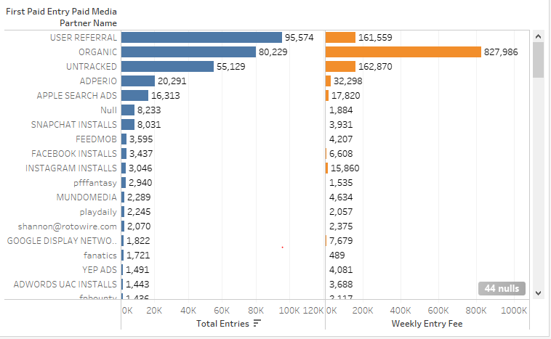
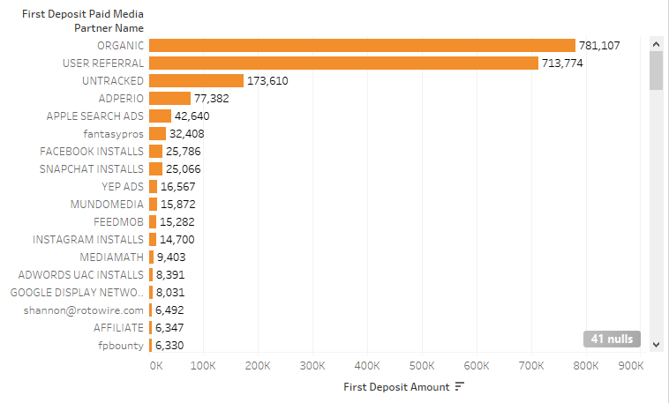
Paid Entry and First Deposit Partners
Majority of the Paid entry was driven from User Referral, Organic and were untracked. The few key partners which drove majority of entries and entry fee were Adperio, Apple Search Ads, Snapchat Installs and Instagram Installs
Like paid entry, Organic, User Referral and Untracked were the main first deposit drivers. The key partners here as well were Adperio, Apple Search Ads, Fantasypros, Facebook and Snapchat Installs.
From this we can understand which partners would help in generating the maximum return on investment and where can we invest our resources.

Slide 12
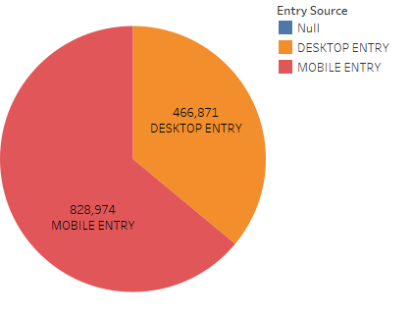
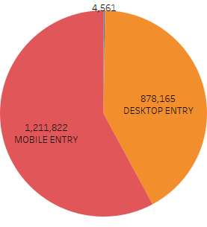
Screen Driven
First Deposit Entry Source
Weekly Fee Entry Source
For both first deposit and weekly fee, we saw that majority of our contributions came from Mobile entry. We observed 58% and 64% mobile entries respectively for the two segments
This analysis shows us that most of our users prefer using a smaller screen as it’s more hands on, easier to operate and has a better mobility while using Fanduel
Hence, targeting on the smaller screen should be prioritized and the spending on services should be in the ratio of 60 – 40 favoring smaller screen to get the maximum outcome.

Slide 13
Numbers
Maximum First Deposit by a Registered User: $2857.53
Conversion Rate of Registration to First Deposit:
34.75%
Average First Deposit in Registered Users: $6.15
Most Entries by a Sport: NFL
110,034 entries
Highest Weekly entry fee by a User:
$42,405.68
Most Weekly Total Entries by a User:
771 entries
Most time taken from Registration to Paid Entry: Twitter
981 days

Slide 14
Question 5

Slide 15
Answer
As we have seasonality as an important factor, we can divide the data into two parts (Non-Seasonal and Seasonal) and run the models with the respective time frames and see impact of each variable during that time.
We can use a multiple linear regression model to see the impact of the different independent variables on our dependent variable (Registrations). The features that we’ll include in the models would be the spends of our media presence like Digital, TV, Radio, Out of Home, Search, League Partnership and Team Partnerships
The reason we are using a multiple liner regression model is because we’ll be able to see the contributions of all our touchpoints together towards the registrations in a form of an equation which will represent the contributions from each variables.
The equation will help us to understand how can we prioritize our media and which media is helping us in getting the maximum number of registrations and which media is having a negative impact on registration.
Also, before we come with an outcome, we’ll test the correlation among the variable to see if any multicollinearity that may skew the results.

Slide 16
Thank You!

